Slide 1
Skewness and Kurtosis
Histogram

Slide 2
What is Histogram?
Histograms are graphical representations of data distributions. They consist of bars, each representing the frequency or count of observations falling within specific intervals, known as bins.
The histogram graphically shows the following:
Frequency of different data points in the dataset.
Location of the centre of data.
The spread of dataset.
Skewness/variance of dataset.
Presence of outliers in the dataset

Slide 3
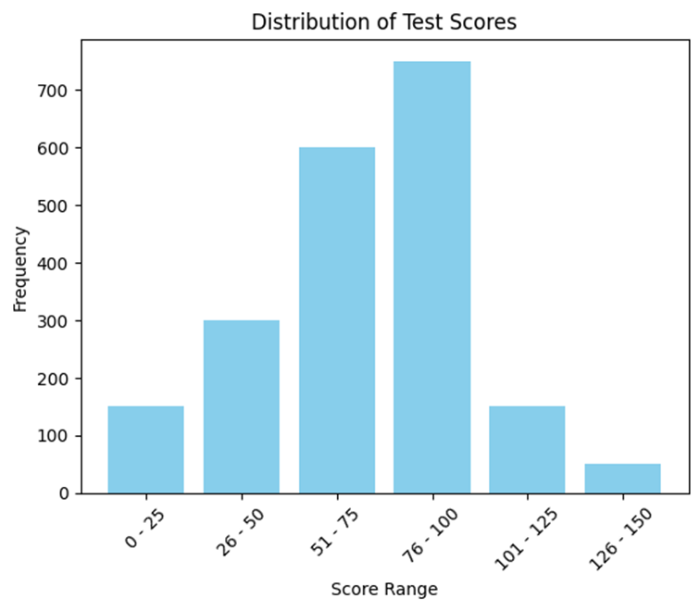
Histogram contains the following axes:
Vertical Axis: Frequency/count of each bin.
Horizontal Axis: List of bins/categories.

Slide 4
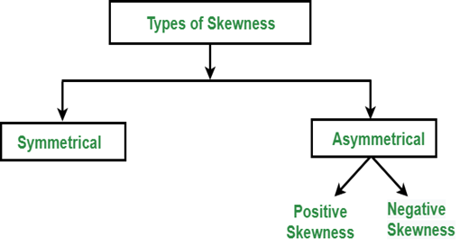
What Is Skewness?
Skewness is an important statistical technique that helps to determine asymmetrical behaviour than of the frequency distribution, or more precisely, the lack of symmetry of tails both left and right of the frequency curve.
A distribution or dataset is symmetric if it looks the same to the left and right of the centre point.

Slide 5
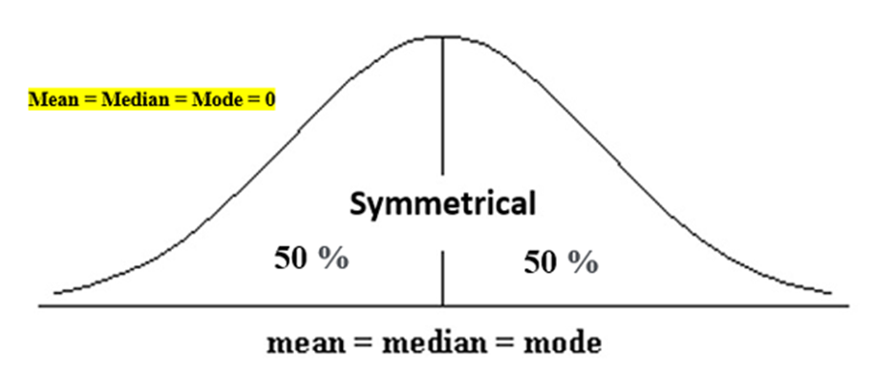
Symmetric Skewness:
A perfect symmetric distribution is one in which frequency distribution is the same on the sides of the centre point of the frequency curve.
In this, Mean = Median = Mode. There is no skewness in a perfectly symmetrical distribution

Slide 6
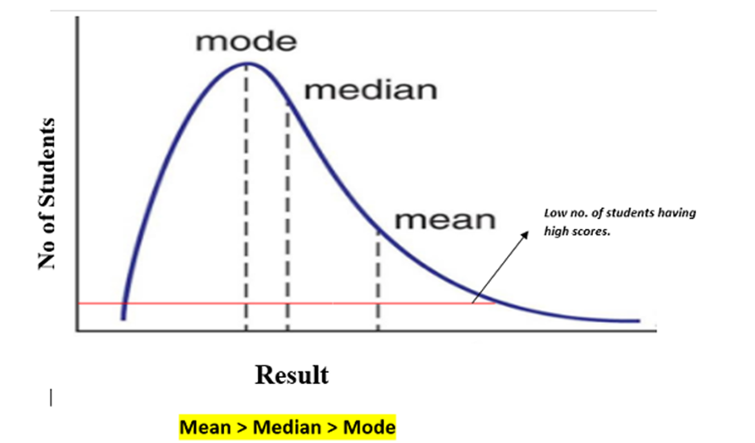
Asymmetric Skewness
A asymmetrical or skewed distribution is one in which the spread of the frequencies is different on both the sides of the centre point or the frequency curve is more stretched towards one side or value of Mean.
Median and Mode falls at different points.
Positive Skewness: In this, the concentration of frequencies is more towards higher values of the variable i.e. the right tail is longer than the left tail.

Slide 7
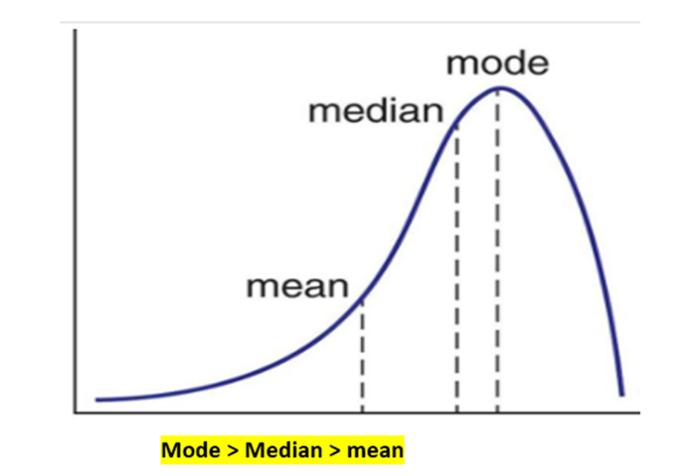
Negative Skewness: In this, the concentration of frequencies is more towards the lower values of the variable i.e. the left tail is longer than the right tail.

Slide 8
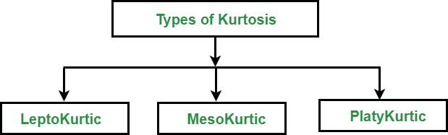
Kurtosis
It is also a characteristic of the frequency distribution. It gives an idea about the shape of a frequency distribution.
Basically, the measure of kurtosis is the extent to which a frequency distribution is peaked in comparison with a normal curve.
It is the degree of peakedness of a distribution.

Slide 9
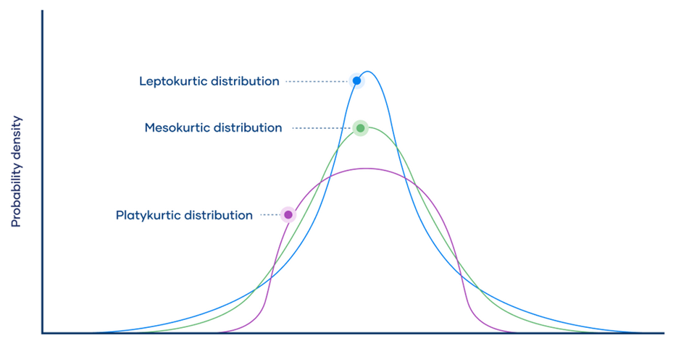
Leptokurtic(>3): Leptokurtic is a curve having a high peak than the normal distribution. In this curve, there is too much concentration of items near the central value.
Mesokurtic(=3): Mesokurtic is a curve having a normal peak than the normal curve. In this curve, there is equal distribution of items around the central value.
Platykurtic(<3): Platykurtic is a curve having a low peak than the normal curve is called platykurtic. In this curve, there is less concentration of items around the central value.

Slide 10
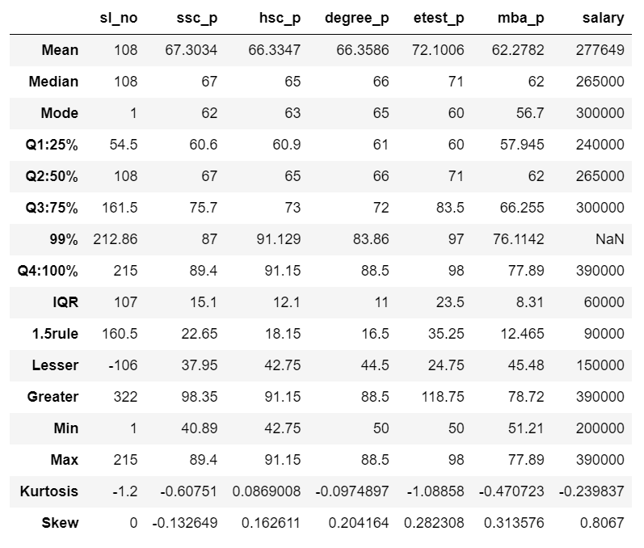
Report for Skew and Kurtosis

Slide 11
Result Set of Placement.csv
 | sl_no | ssc_p | hsc_p | degree_p | etest_p | mba_p | salary
Skew | Normal or Symmetric Skewness | Negative Skewness | Normal or Symmetric Skewness | Normal or Symmetric Skewness | Normal or Symmetric Skewness | Normal or Symmetric Skewness | Normal or Symmetric Skewness
Kurtosis | Platykurtic | Platykurtic | Platykurtic | Platykurtic | Platykurtic | Platykurtic | Platykurtic
Skew -> Except ssc_p rest values are equal to 0 so it is normal or symmetric skewness and ssc_p has -0.13 so it is negative skewness
Kurtosis -> Result of all column values are <3 so it is platykurtic.

